Slide 1

Smart Classroom
- Team members:
1- Mostafa Usama
2- Mohamed Ramadan
3- Mohamed Nabil 4- Nourhan Mahmoud
5- Sondos Osama
6- Manar Mohamed
- Supervised by:
Dr. Abdelrahaman Hedar

Slide 2
Agenda
Motivation
System Overview
System Workflow
Tools
Future Work
Demo

Slide 3

Motivation

Slide 4
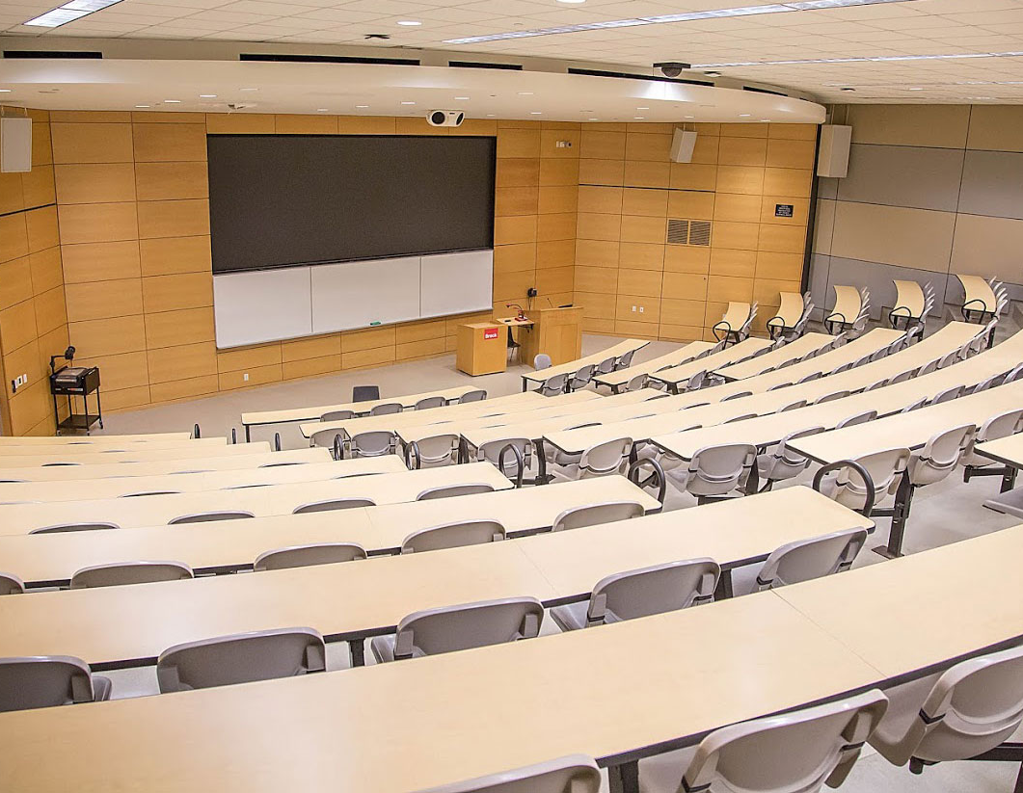
Too much wasted Energy !!

Slide 5

So, what can we do?

Slide 6

System Overview

Slide 7



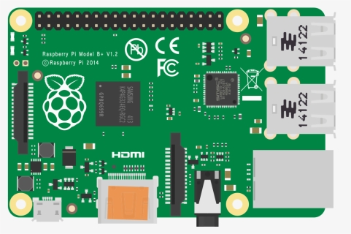



Architecture

Slide 8

System Workflow

Slide 9
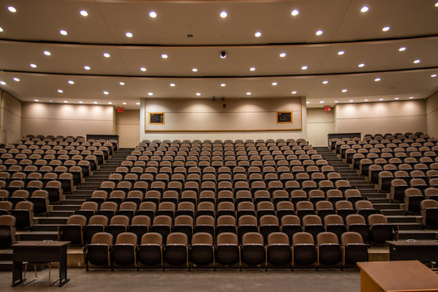
Sections

Slide 10
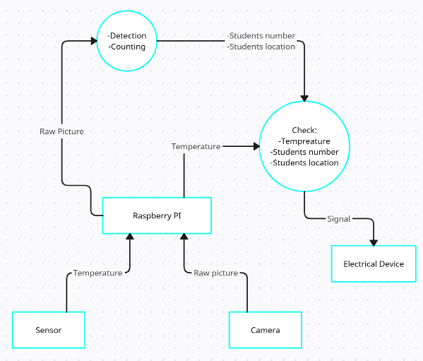
System Workflow

Slide 11



Tools

Slide 12
Future Work
Better Accuracy
User interface
Voice Control

Slide 13
Demo

Slide 14
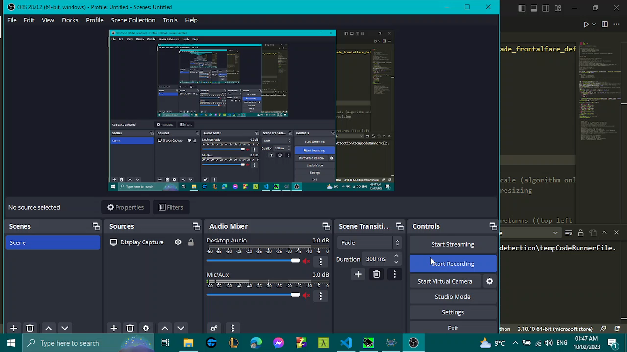

Slide 15

THANK YOU

